Slide 1
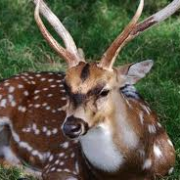
The Axis Deer
By Kennedy Goad

Slide 2
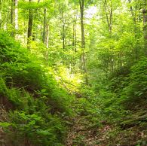
What is the animal’s habitat?
The axis deer lives in the forest.

Slide 3
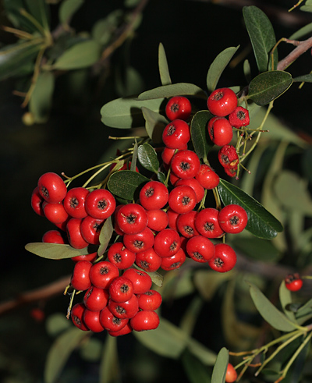
What does the axis deer eat?
The axis deer eats grass and berries.

Slide 4
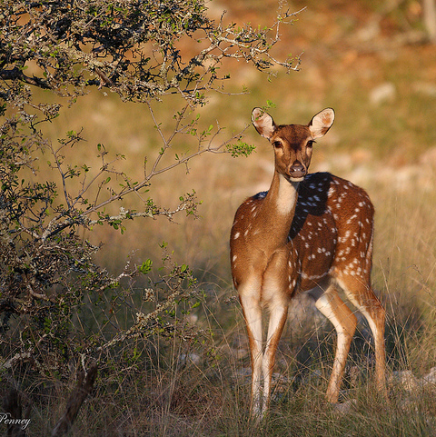
What color is the axis deer?
The axis deer is brown with white dots.

Slide 5
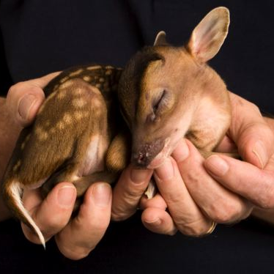
Do axis deer have babies or lay eggs?
Axis deer have babies.

Slide 6
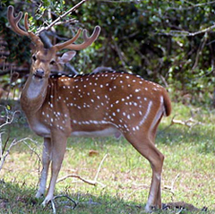
How big are axis deer and how much do they weigh?
- They are between 26 and 39 inches tall.
They weigh between 90 and 250 pounds.
They are about the same size as a big dog!

Slide 7
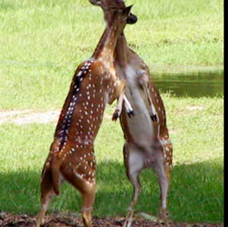
An interesting fact
Girl deer fight more than boy deer.

Slide 8
A question I still have…
How do they protection themselves from other animals?

