Slide 1
John’s Zoo Report
Gila Monster

Slide 2
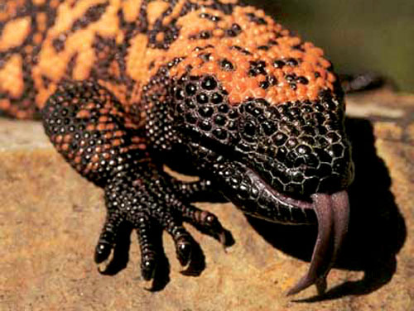
This is a Gila Monster.

Slide 3
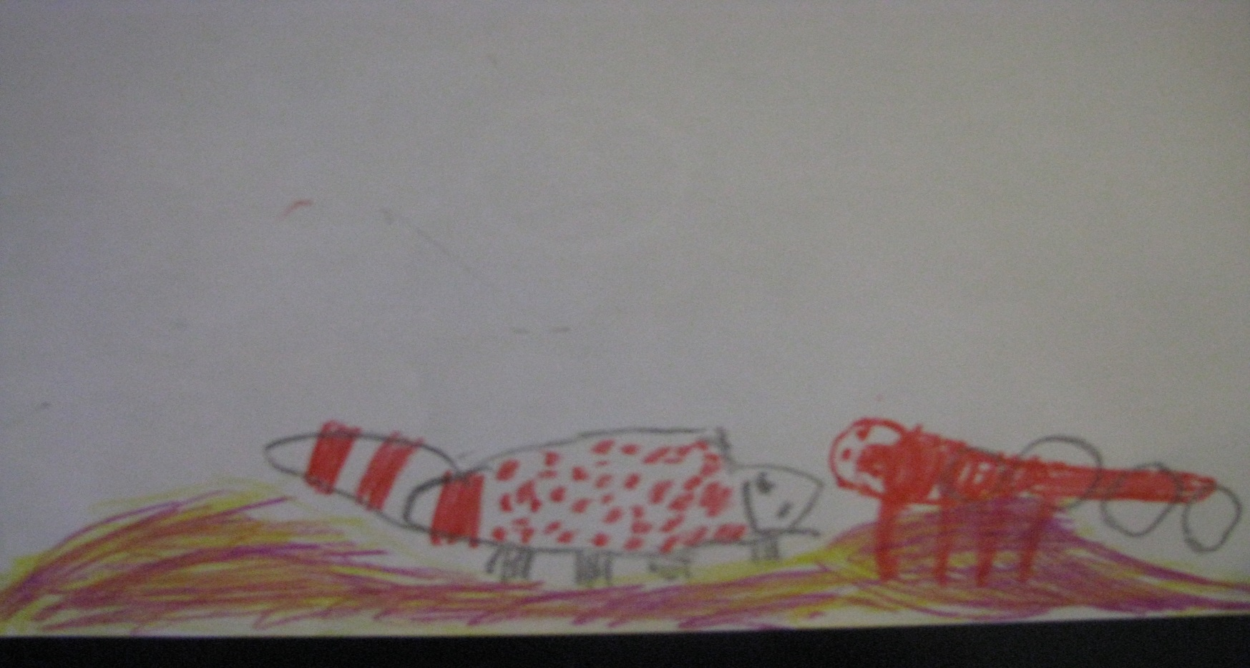
The Gila Monster’s habitat is in the desert. It likes to live under the ground. You can find them most in Arizona and Northwest Mexico.
Here is a picture of the Gila Monster in the desert getting ready to eat.
They like to eat animal eggs and newborn mammals. They only eat 3 or 4 times a year and store lots of energy in their body for a long time.

Slide 4
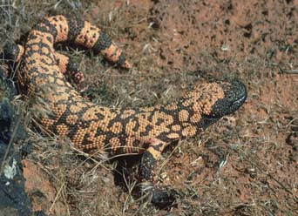
Gila Monsters have a black body with pink, orange or yellow marks with black bands on the tail. They have scales. They lay eggs like other lizards. A Gila Monster can grow up to 22 inches long and more than 5 pounds.

Slide 5
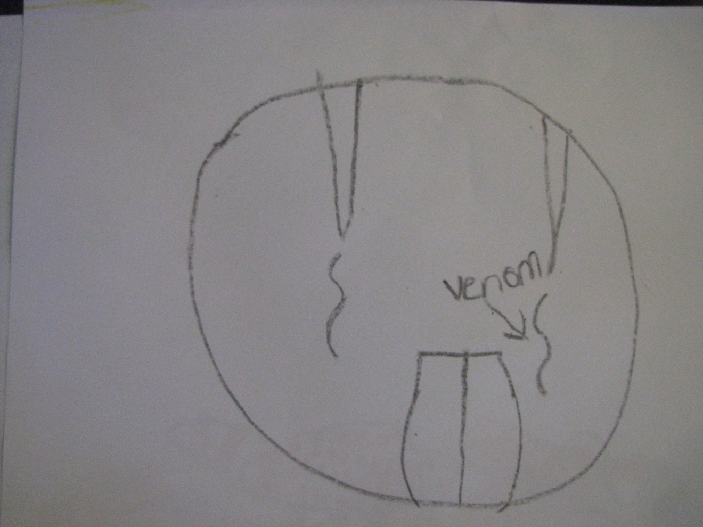
Interesting Facts: A Gila Monster is the largest lizard in the United States. It is a poisonous lizard. When it bites something, it chews on it to let the venom come out of cracks in its teeth. No one has been killed by its bite, but it really hurts.

Slide 6
Questions I would like to ask!
Why are they so scary?
What animals like to eat the Gila Monster for food?

