Slide 1
The Llama
By Madison Miller

Slide 2
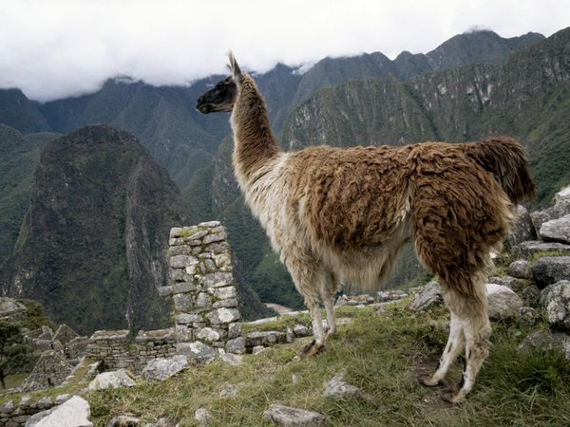
Where do I live?
Mountains of South America

Slide 3
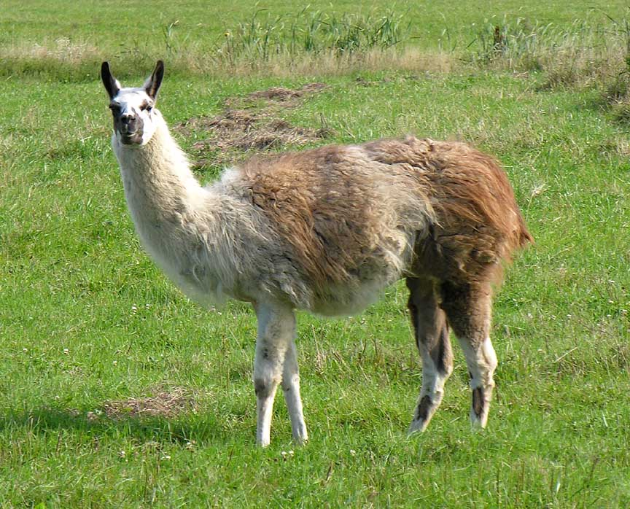
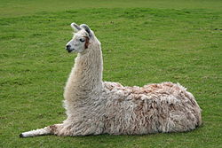
What do I like to eat?
I am a herbivore and like to eat grass and hay

Slide 4
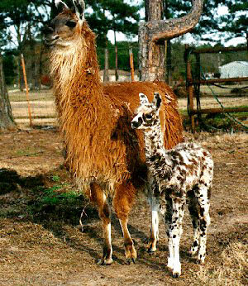
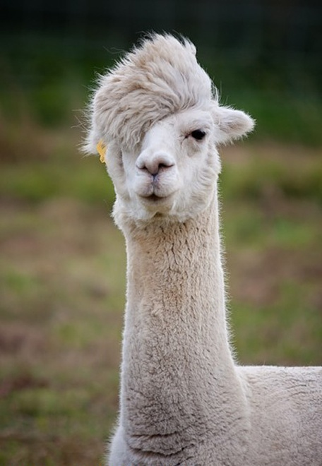
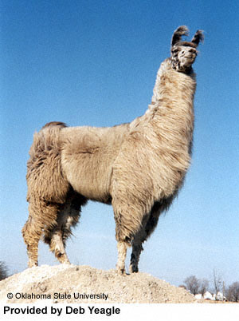
What color am I?
I come in many different colors and patterns including black, brown, white, and everything in between.

Slide 5
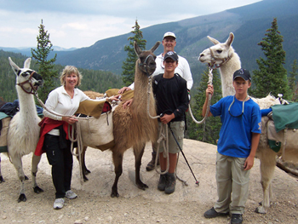
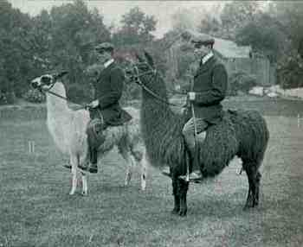
How big will I get?
I can grow up to 6 feet tall and weigh up to 250 pounds.

Slide 6
Interesting facts about me
I can be stubborn like a donkey
I wrestle other llamas with my neck
When I get mad I can spit and kick
I come in all different colors
I can be trained to be ridden

Slide 7
The End

