Slide 1
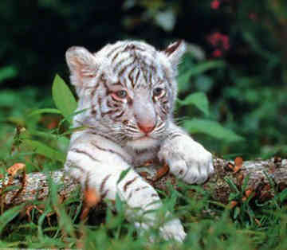
White Tiger by Ryan Hudelson
My animal lives in the Zoo and some in the Jungle
My animal eats a lot of Meat---Deer, leopards, and camels. They hunt at night for their food!

Slide 2
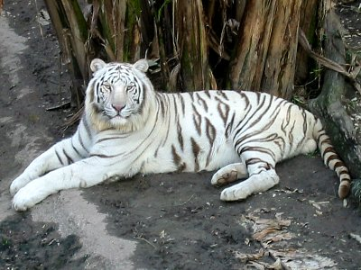
The color of my animal is White with Black stripes.
My animal has white fur . He is soft like a cat.
My animal has babies…..they have 2 or 3 at a time (Litter)
My animal weighs about 400 to 500 pounds. It is the biggest of all the cats.
The most interesting fact is they can run 40mph.
How many white tigers are left in the world?

Slide 3
