Slide 1
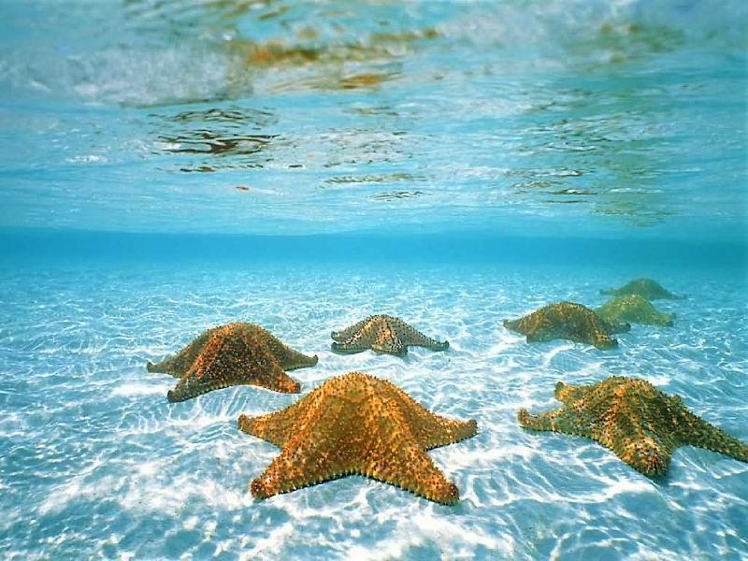
Starfish (Sea Star)
Joel Jeong

Slide 2
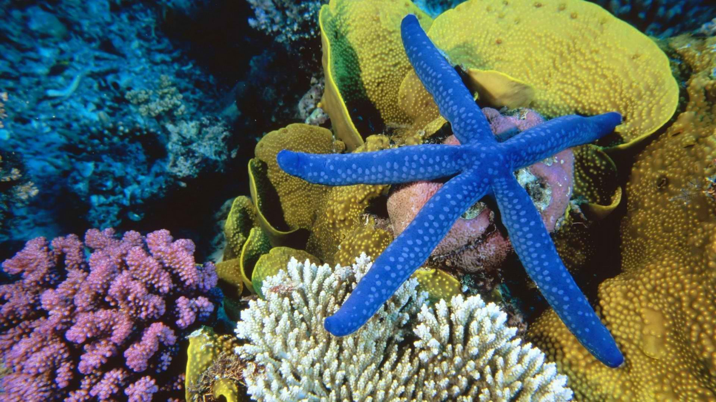
Starfish live on the sea bed

Slide 3
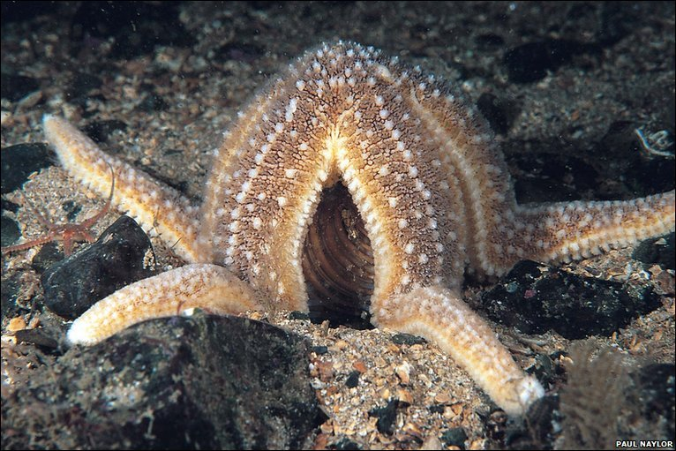
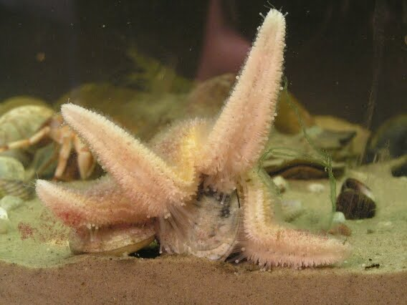
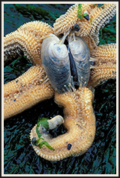
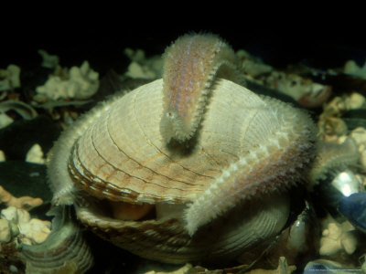
Starfish eat Shell
It wraps the shell tightly, then pushes its stomach out of its mouth and eats
http://www.youtube.com/watch?v=l6dnmLDu6Eg

Slide 4
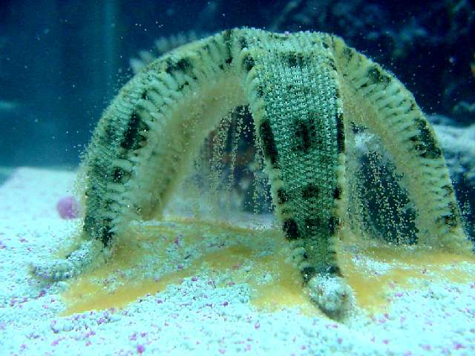
Starfish lay eggs

Slide 5
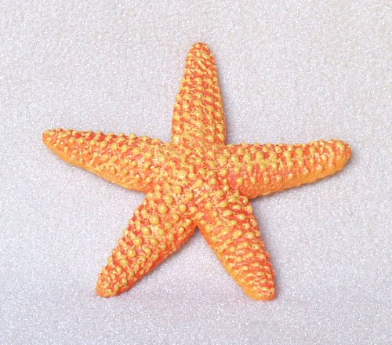
Starfish characteristic
Size : 5 ~ 10 inch
Weight : up to ~ 11lb

Slide 6
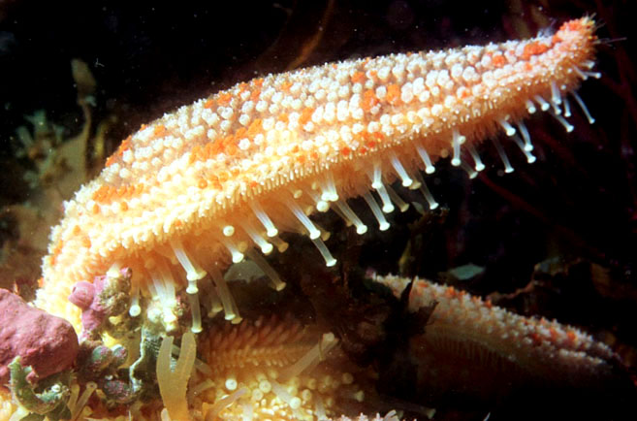
Starfish move using their tube feet

Slide 7
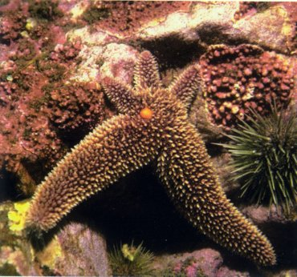
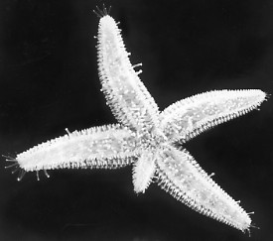
Starfish can regenerate lost arms

